Slide 1
Azure SignalR Service
Tomasz Wiśniewski
Cloud Solution Architect

Slide 2
About me
Cloud Solution Architect @ Demant Technology Centre

Slide 3
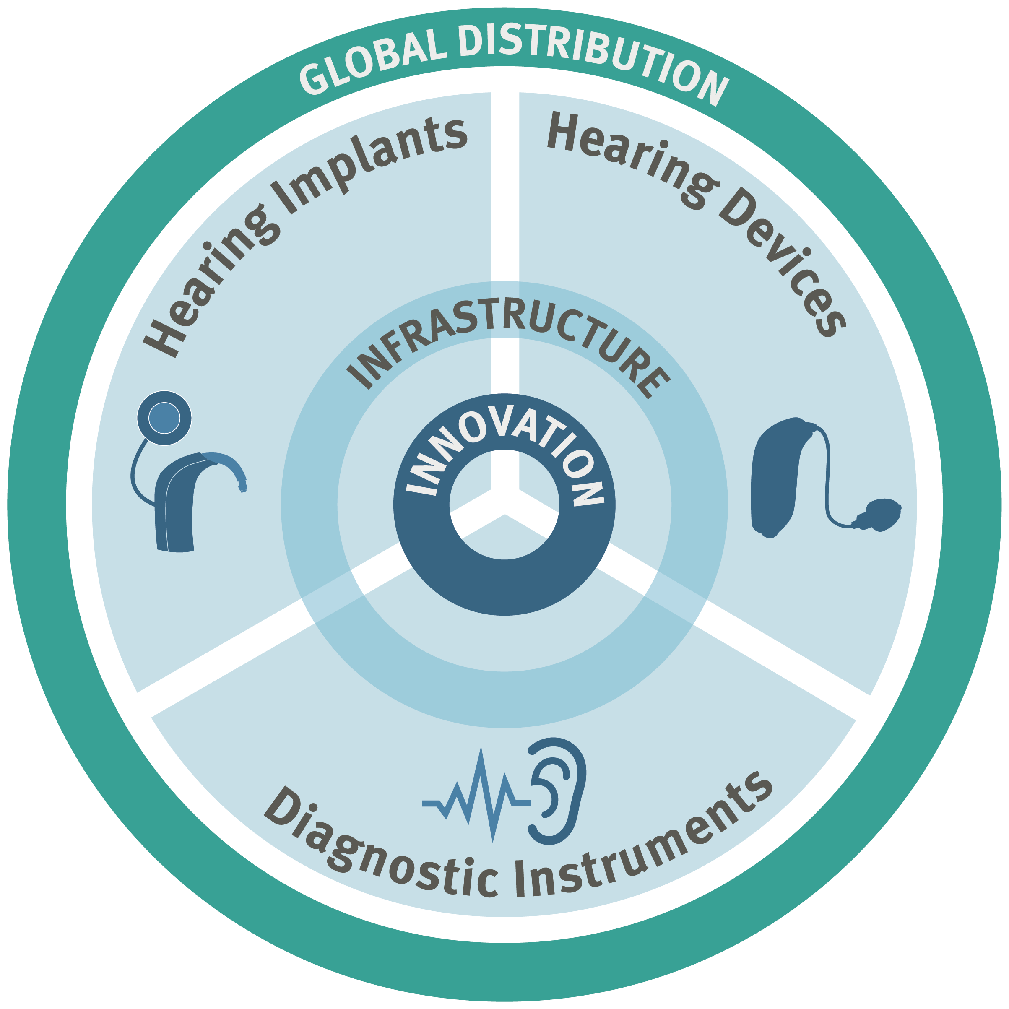
Strategy
The William Demant Group is a leading, broadly based and growth-oriented hearing healthcare company
With the broadest and deepest product offering based on true innovation
Customers and end-users reached through a multi-brand approach
A comprehensive, global distribution set-up backed by efficient shared services.

Slide 4



About me
Cloud Solution Architect @ Demant Technology Centre
Technology lover
https://github.com/wi5nia
http://azure.tomaszwisniewski.com
@wisniewskit

Slide 5
Real Time

Slide 6
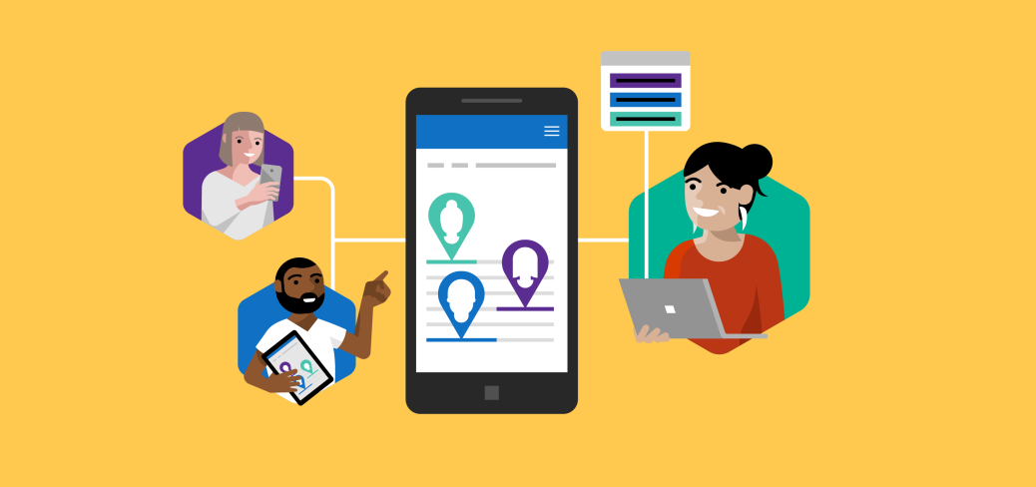



Real Time Scenarios Are Everywhere Real time technologies are integral to many popular apps
Co-authoring
Real time location based tracking
In-app notification
Live Dashboard

Slide 7
About SignalR
ASP.NET Core SignalR
Open-source library for adding real-time web functionality to apps
Supporting bi-directional server-client communication
Sending messages to all, specific, or group of clients
WebSocket, server-sent events, and long polling transports support
SignalR replaces user polling and Ajax long polling/comet
Connection management, grouping connections, and authorization APIs
Scale with backplane with Redis, SQL Server or Azure Service Bus
Transition from Non-core ASP.NET based to ASP.NET Core SignalR

Slide 8

SignalR on old-school clients or servers
Got Data?
Got Data?
Got Data?
Got Data?
Here’s some data!
Got Data?
Client
Got Data?
Server
Got Data?
Got Data?

Slide 9
SignalR on new-school clients or servers
I do real time, do you?
Yeah, dude!
Let’s Party in Real-time!
Client
Server

Slide 10

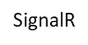
Azure SignalR Service
Fully managed service—without worrying about capacity provisioning, scaling or managing connections
Native ASP.NET Core SignalR development support
New possibilities when integrating with other Azure services
Available in growing global regions
Azure App Service
Web App
Web App
Browser
Azure App Service
Browser
Azure SignalR Service
Self-hosted SignalR
Managed SignalR Service

Slide 11
Running on Azure SignalR Service
Web
Application
SignalR
Service
Business Logic (Hub)
Server Endpoint
Pages
Client Endpoint
SignalR traffic
Web traffic
Client Browser

Slide 12
Using the Azure SignalR Service
Application connects to service via a connection string
Service response includes access token & URL for client connections
Clients send negotiate request to app which returns access token & URL
https://github.com/aspnet/SignalR/blob/release/2.2/specs/TransportProtocols.md
Client connects to service using access token & URL from app
Service relays messages from server to clients and clients to server

Slide 13
SignalR in-app vs. SignalR Service
In-app
SignalR Service
Hub
HubConnectionHandler
ConnectionsRouteBuilder
HttpConnectionDispatcher
RoutingMiddleware
ASP.NET Core HTTP Pipeline
Hub
HubConnectionHandler
WebSocket Clients
ServiceHubDispatcher

Slide 14
Initial feature sets for Azure SignalR Service
Inherited from ASP.NET Core SignalR
DevOps Tooling
Performance and Scaling
Transport protocols and platforms supported
Real time bi-directional messaging via Hubs
Authentication and authorization
Connection and user/group management
Hub Protocol: JSON and MessagePack (Binary)
ARM support/CLI provision
Monitoring dashboard with log access
Management via Azure portal
Rich x-platform SDKs/Libs
Redis based backplane scaling
Layer-7 load balancer
Available in multiple global regions
SLA (99.9% uptime)
Optimal latency on server side: 99% messages transmitted < 1 sec

Slide 15
SignalR Service
Who may use SignalR Service?
Customers who want to
Add real-time features to existing Azure web app
Out-source SignalR backend
Build new real-time web app
What are the unique benefits?
From ASP.NET Core
From Azure Infrastructure
Improved performance and stability
Cross-platform
Native dev and tooling support
Global reach, world class data center, scale, SLA, network, monitor, security and compliances
Easy integration with other Azure services: Storage, App Service, Analytics/BI, IoT, AI…

Slide 16
Typical scenarios
Market Segments
Scenarios
Banking
Education
Real-time Messaging
Market Live data
Trading
Collaboration
RT interaction
Live video broadcast
RT chat
RT data update/broadcast
1:1, 1:n, m:n via server
Chat bot, group chat, in-game chat, messenger, etc.
Producer: consumer(s), 1:n
Dashboard, scoreboard, RT data on chart, on map, news, alert, price update, RT ad, etc.
Messaging/Social
Government
Live chat
Messenger
Collaboration
Voting
Polling
RT state/event update/notification
Devices, user on/offline, typing indicator, RT event trigger
Gaming
eCommerce
RT Game
In-game chat
Multi-player scoreboard
Auction
Betting
Customer support and chatbot
High frequency RT and RT stream (future focus)
RT game, auction, betting, stock trading, VoIP, streaming
Advertising
Connected Devices
Typical client types
Web browser and mobile browser, desktop app, mobile app, server process, IoT devices, game consoles
RT targeting
Push ads
Streaming ads
Smart home/city
Remote control
RT status/location tracking

Slide 17
Demo

Slide 18
Client Targeting with SignalR Hubs
Client “Andrew”
(Dev)
Client “Damian” (PM)
Hub
Client “Glenn” (PM)
Clients.All.doWork()

Slide 19
Client Targeting with SignalR Hubs
Client “Andrew”
(Dev)
Client “Damian” (PM)
Hub
Client “Glenn” (PM)
Clients.Caller.doWork()

Slide 20
Client Targeting with SignalR Hubs
Client “Andrew”
(Dev)
Client “Damian” (PM)
Hub
Client “Glenn” (PM)
Clients.Others.doWork()

Slide 21
Client Targeting with SignalR Hubs
Client “Andrew”
(Dev)
Client “Damian” (PM)
Hub
Client “Glenn” (PM)
Clients.Group(”Dev").doWork()

Slide 22
Client Targeting with SignalR Hubs
Client “Andrew”
(Dev)
Client “Damian” (PM)
Hub
Client “Glenn” (PM)
Clients.User(“Glenn”).doWork()

Slide 23
Azure Functions + Azure SignalR Service

Slide 24
Azure Functions + SignalR Service
Use WebSockets in serverless apps
Add real-time messaging to other Azure Services
Code in multiple languages
JavaScript, C#, Java*, Python*…

Slide 25

Real-time messaging everywhere
Browsers
Desktop
Mobile
Games
HTTP
Timers
Orchestrations

Slide 26
Real-time messaging everywhere
Event Hubs
Event Grid
Cosmos DB
Queue
Service Bus
Microsoft Graph
Browsers
Desktop
Mobile
Games

Slide 27
Real-time messaging everywhere
Browsers
Desktop
Mobile
Games
Twitter
Salesforce
Slack
PagerDuty
SQL Server
…

Slide 28
SignalR Service bindings for Azure Functions
In preview today!
SignalRConnectionInfo (input)
SignalR (output)

Slide 29

SignalRConnectionInfo input binding
[FunctionName(nameof(GetSignalRInfo))]
public static IActionResult GetSignalRInfo(
[HttpTrigger()] HttpRequest req,
[SignalRConnectionInfo(HubName = "chat")]
SignalRConnectionInfo connectionInfo)
{
return new OkObjectResult(connectionInfo);
}

Slide 30
SignalR output binding
[FunctionName(nameof(SendMessage))]
public static Task SendMessage(
[HttpTrigger()] object message,
[SignalR(HubName = "chat")]
IAsyncCollector<SignalRMessage> signalRMessages)
{
// function body
}

Slide 31
SignalR output binding
// function body
return signalRMessages.AddAsync(
new SignalRMessage
{
Target = "newMessage",
Arguments = new [] { message }
});

Slide 32


Azure Cosmos DB
Browser
Desktop App
Mobile App
Game
Changes
Collection
1
Azure Functions
Azure SignalR
Service
2
Change Feed
3
4
5
Cosmos DB trigger
SignalR output binding
WebSockets

Slide 33
Demo

Slide 34
Thank You!

